Slide 1
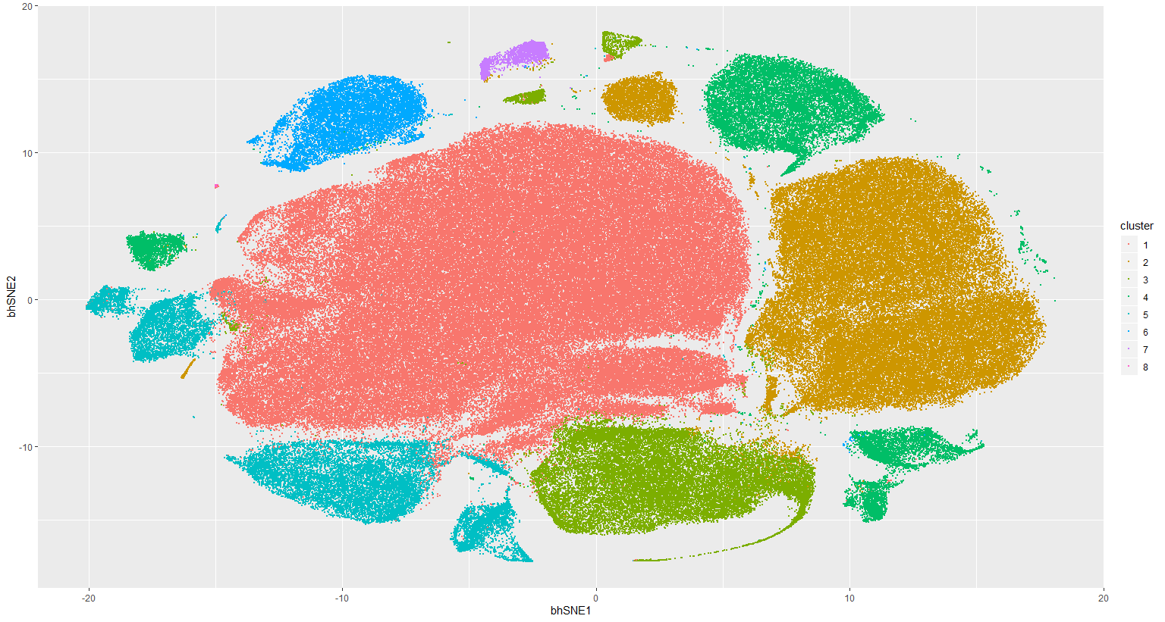
Notes:
ccRCC_652T_Tcells 8
1

Slide 2
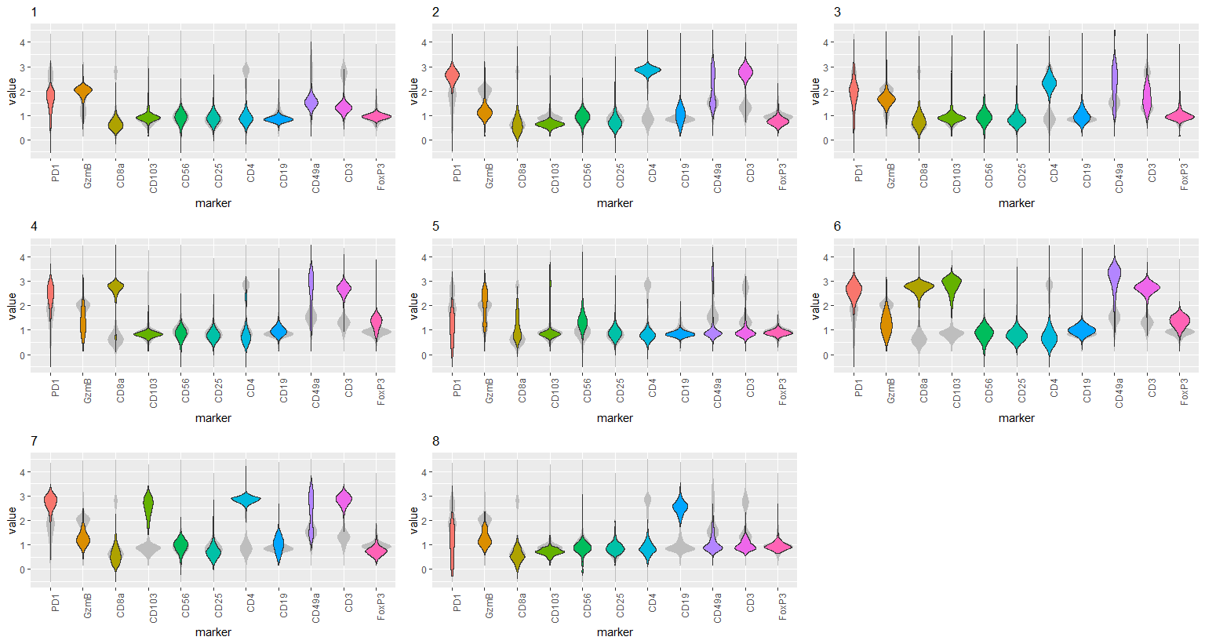
Notes:
ccRCC_652T_Tcells 8
2

Slide 3
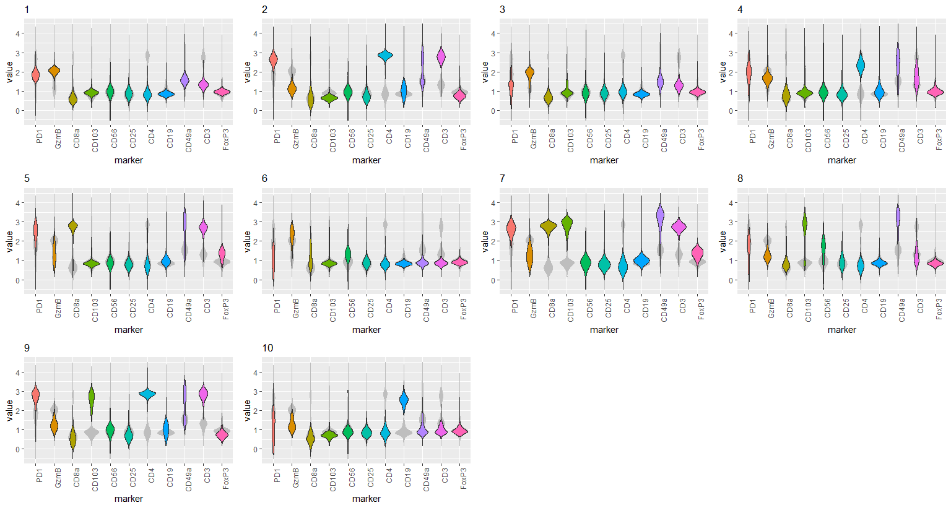
Notes:
ccRCC_652T_Tcells 10
3

Slide 4
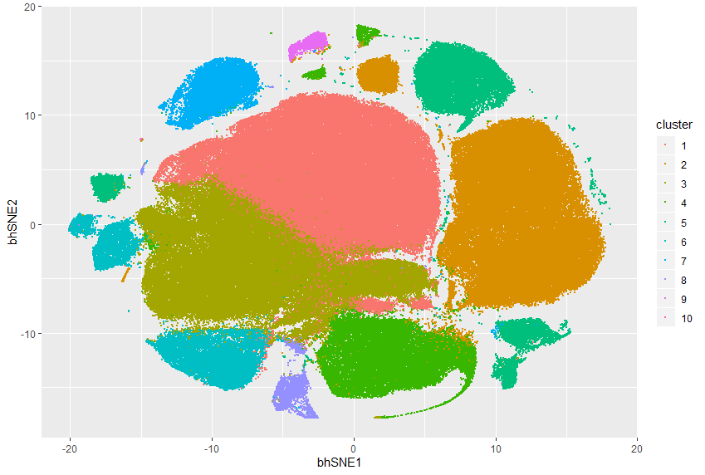
Notes:
ccRCC_652T_Tcells 10
4

Slide 5
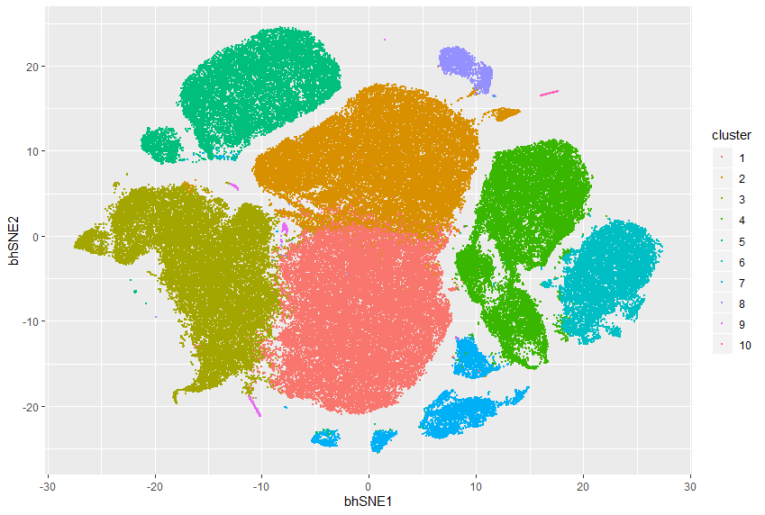
Notes:
ccRCC_652T_Tcells 10 removal of insensitive cluster
Ideas: 1. Removal of insensitive cluster
2. Use of weighted outlier for subclustering 7 for example
5

Slide 6
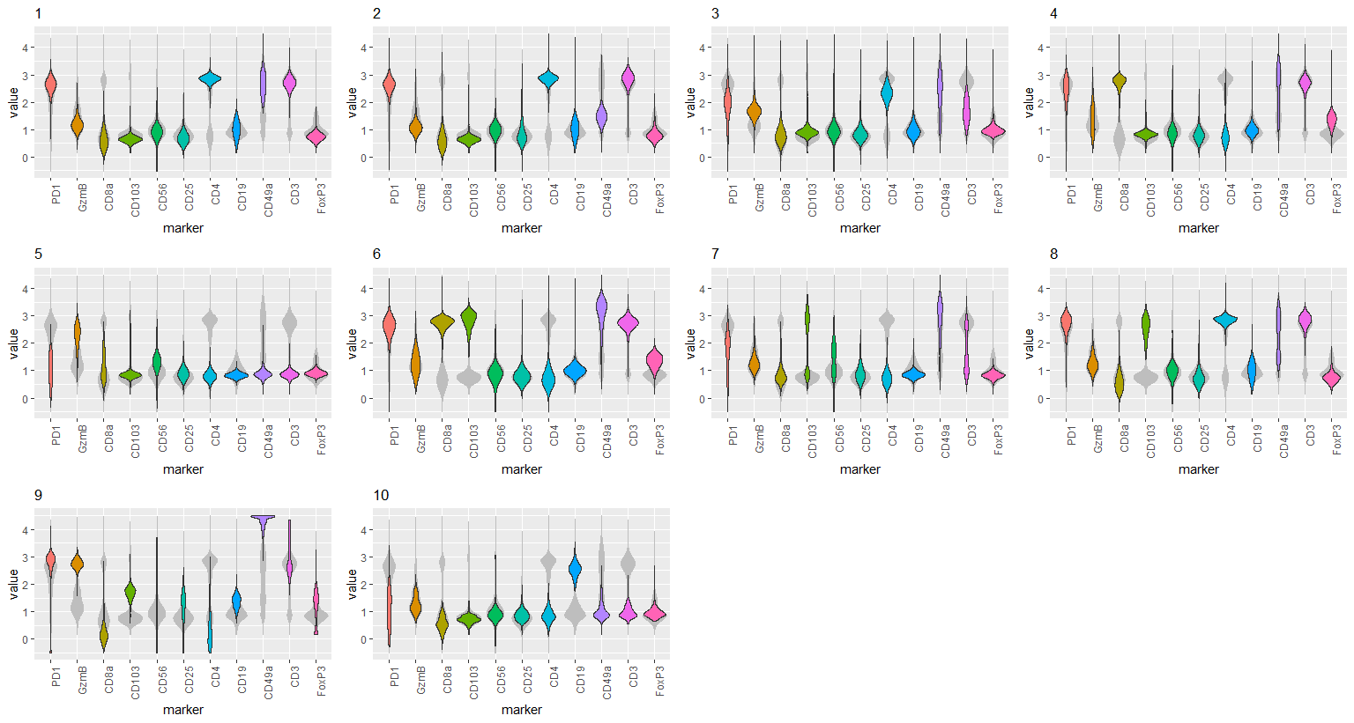
Notes:
ccRCC_652T_Tcells 10 removal of insensitive cluster
6

Slide 7
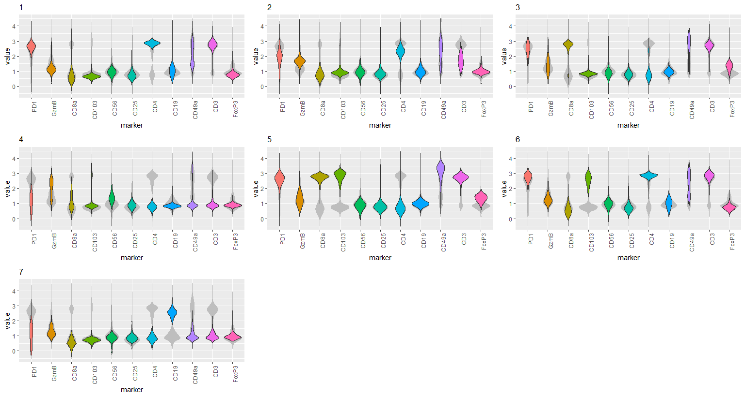
Notes:
ccRCC_652T_Tcells 7 removal of insensitive cluster
7

Slide 8
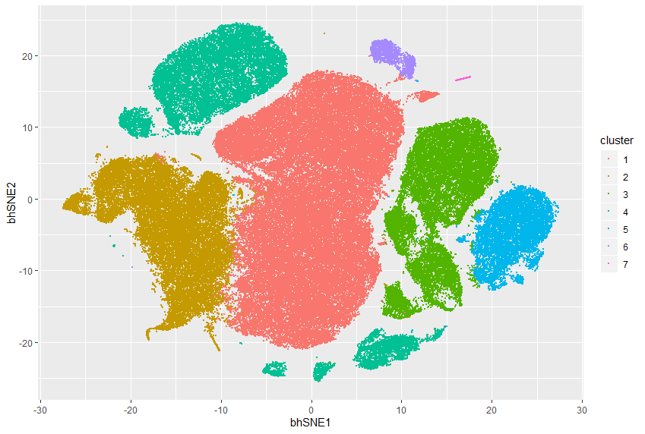
Notes:
ccRCC_652T_Tcells 7 removal of insensitive cluster
8

Slide 9
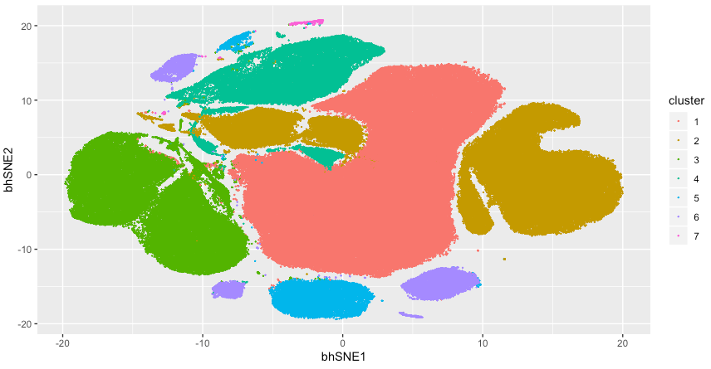
Notes:
ccRCC_652T_Lineage 7

Slide 10
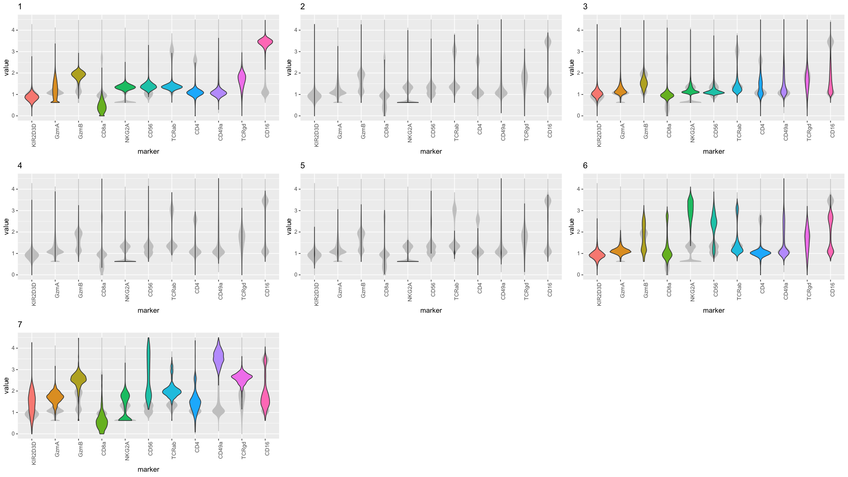
Notes:
ccRCC_652T_Lineage 7

Slide 11
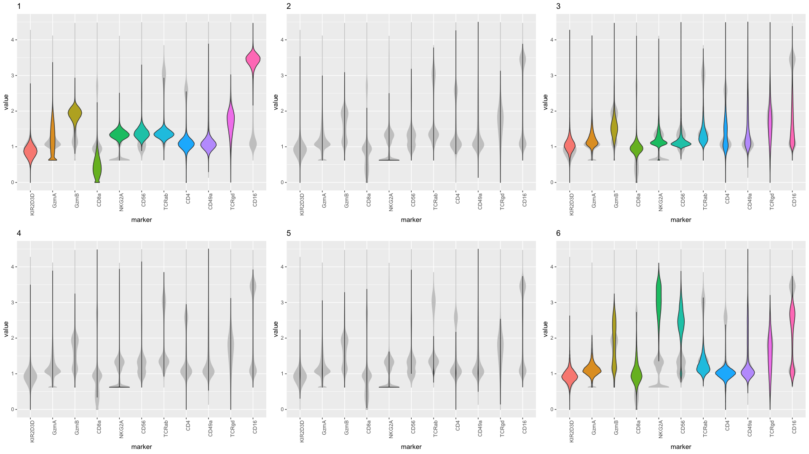
Notes:
ccRCC_652T_Lineage 6

Slide 12
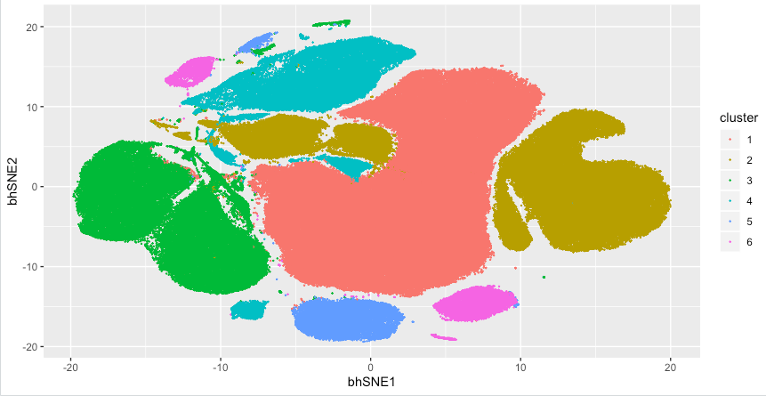
Notes:
ccRCC_652T_Lineage 6

Slide 13
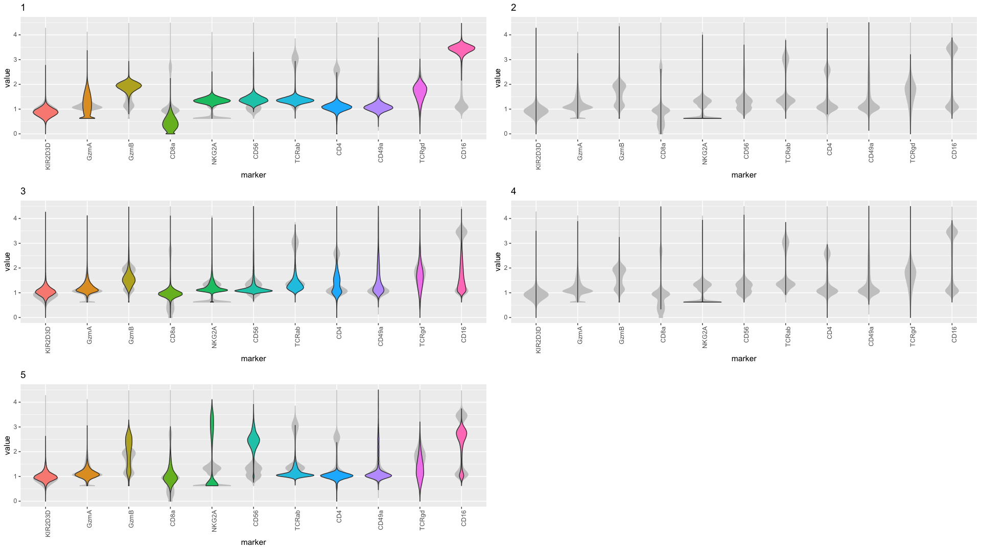
Notes:
ccRCC_652T_Lineage 5

Slide 14
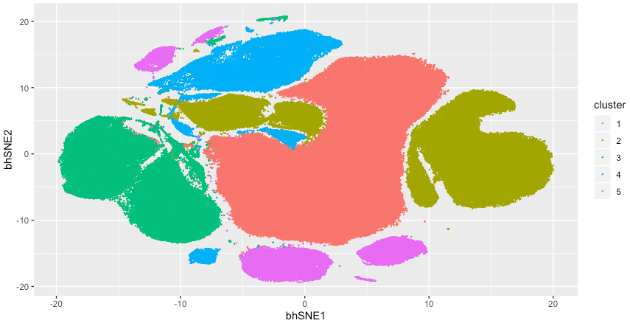
Notes:
ccRCC_652T_Lineage 5

Slide 15
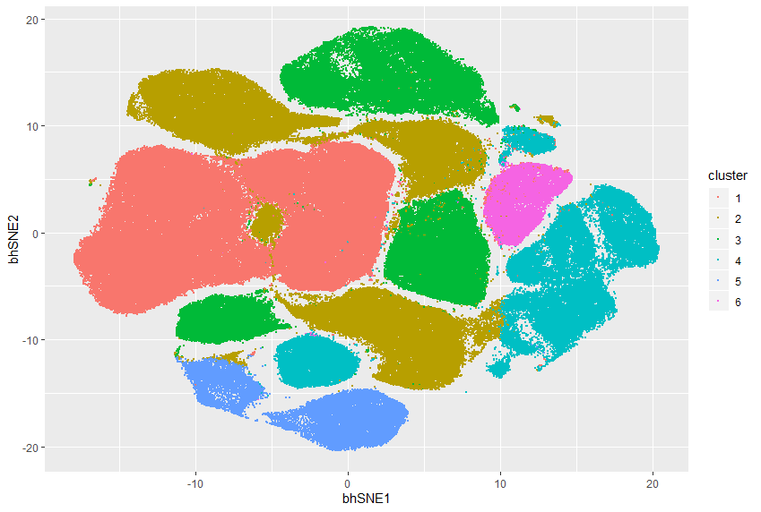
Notes:
ccRCC_643T_Tcells 6

Slide 16
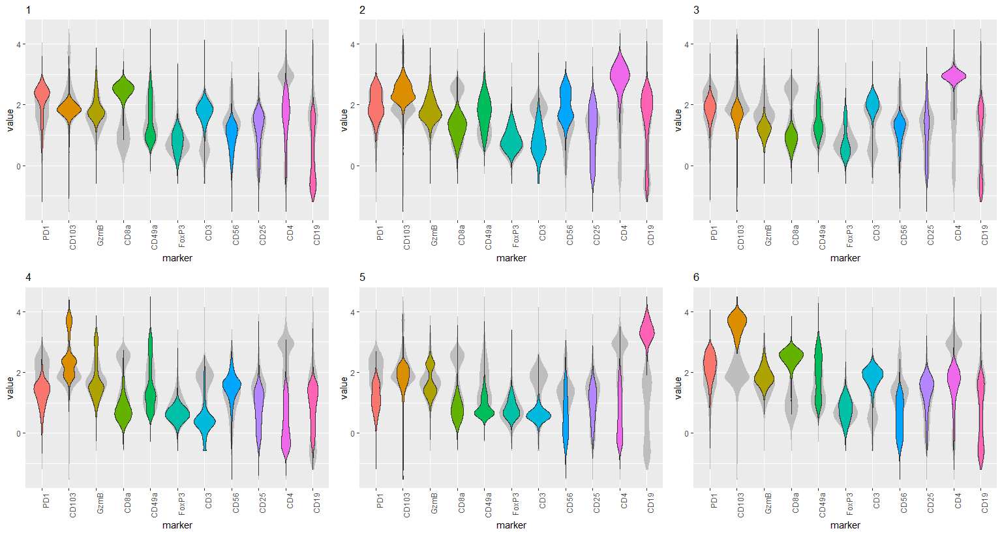
Notes:
ccRCC_643T_Tcells 6

Slide 17
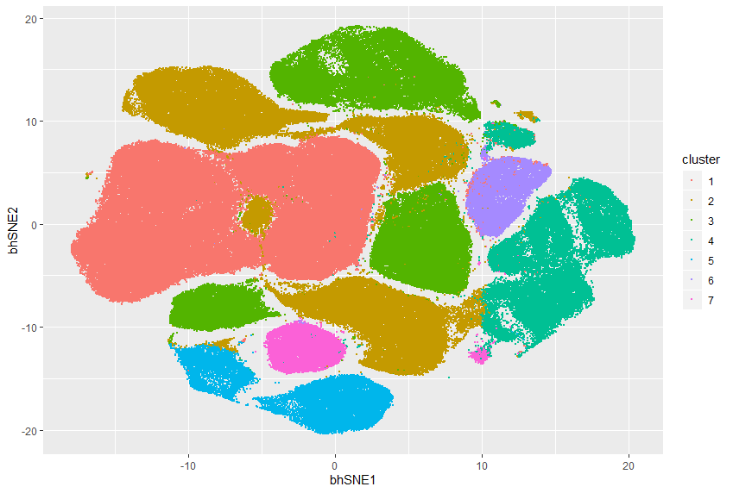
Notes:
ccRCC_643T_Tcells 7

Slide 18
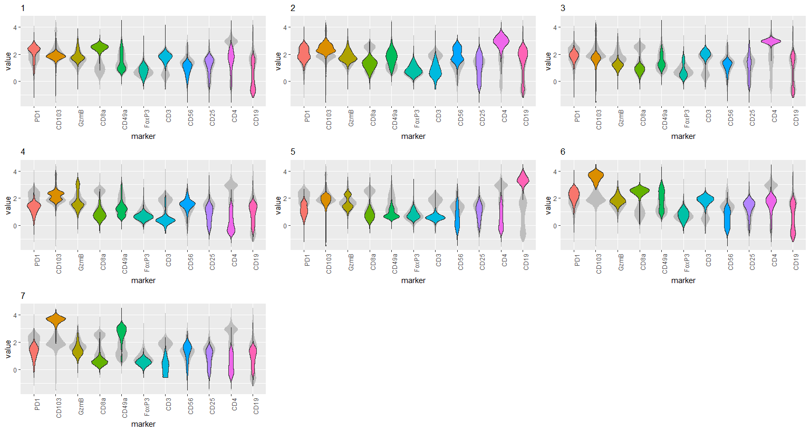
Notes:
ccRCC_643T_Tcells 7

Slide 19
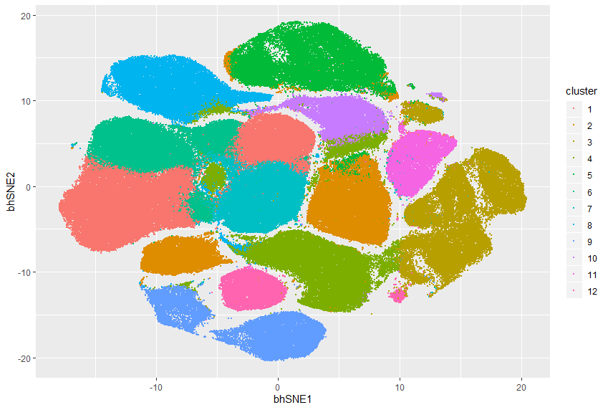
Notes:
ccRCC_643T_Tcells 12

Slide 20
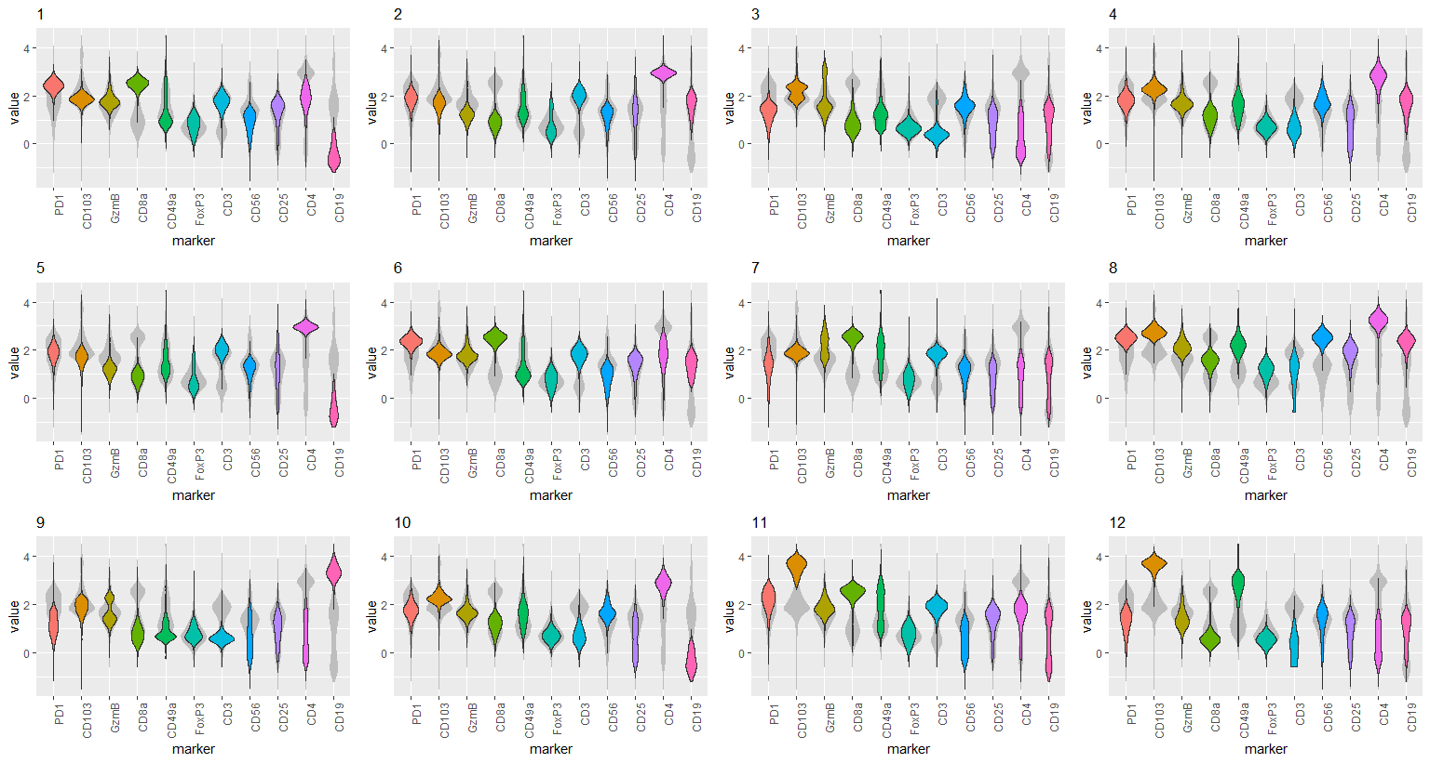
Notes:
ccRCC_643T_Tcells 12

Slide 21
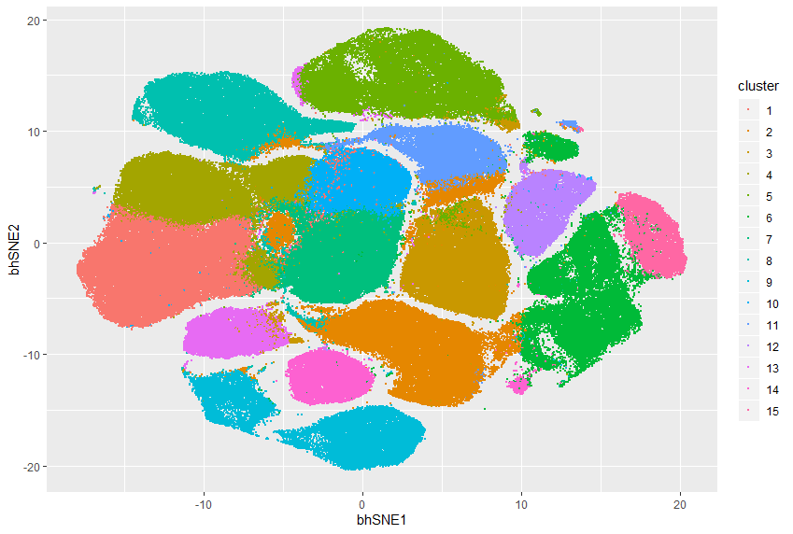
Notes:
ccRCC_643T_Tcells 15

Slide 22
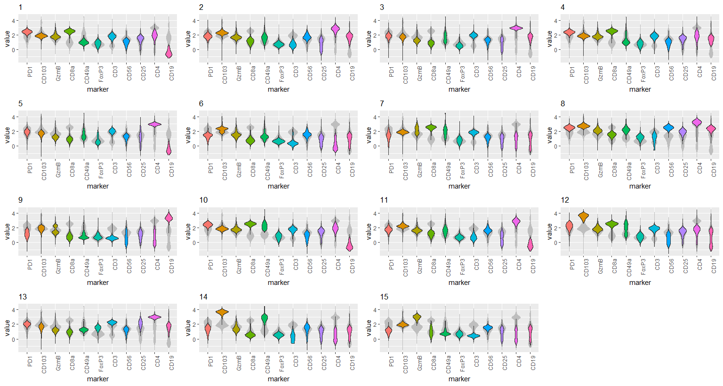
Notes:
ccRCC_643T_Tcells 15

Slide 23
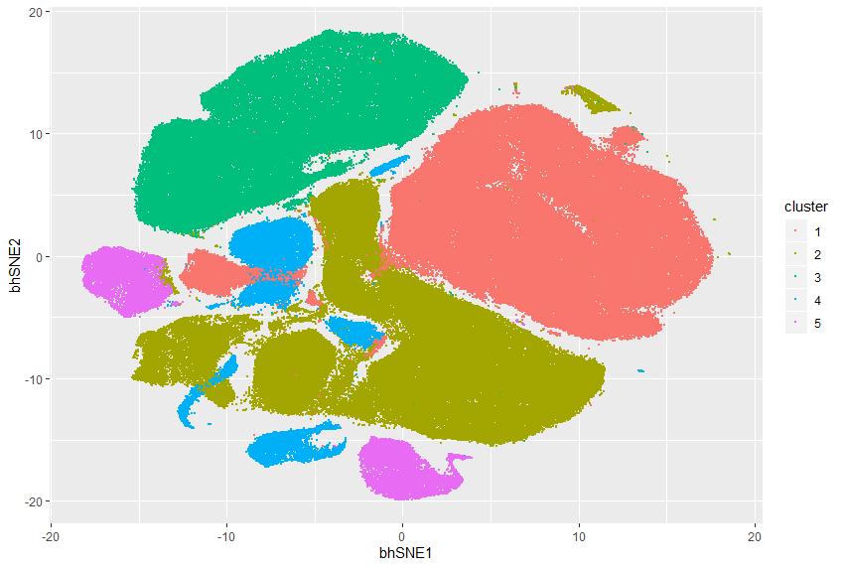
Notes:
ccRCC_643T_Lineage 5

Slide 24
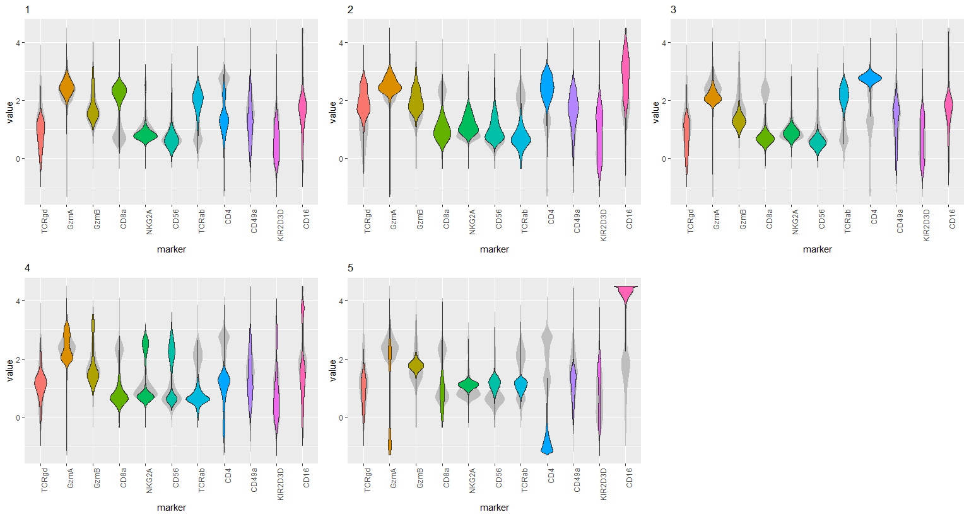
Notes:
ccRCC_643T_Lineage 5

Slide 25
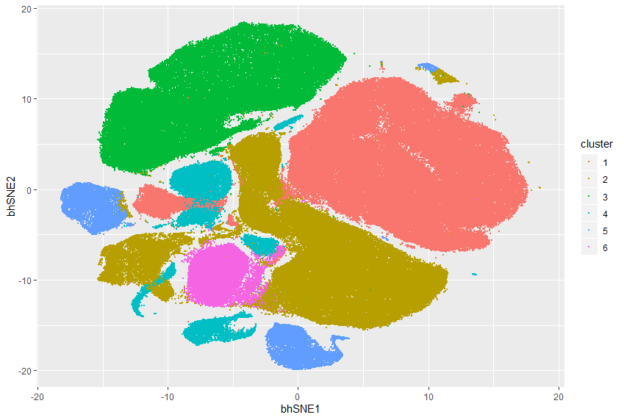
Notes:
ccRCC_643T_Lineage 6

Slide 26
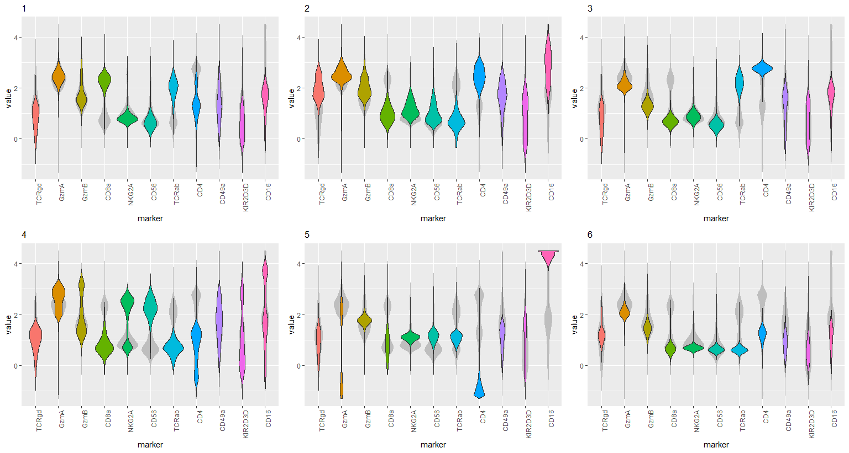
Notes:
ccRCC_643T_Lineage 6

Slide 27
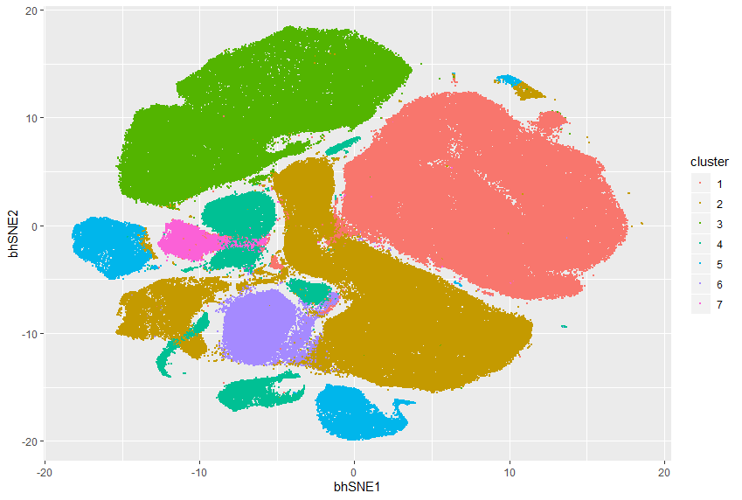
Notes:
ccRCC_643T_Lineage 7

Slide 28
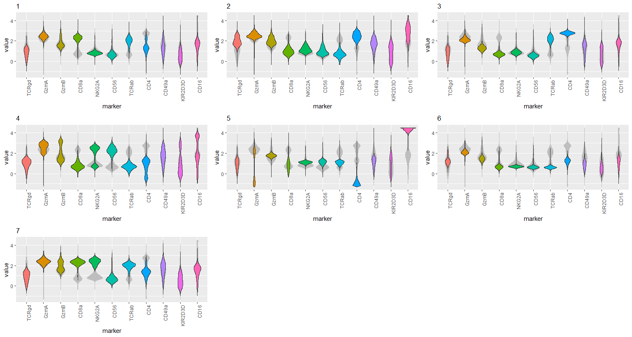
Notes:
ccRCC_643T_Lineage 7

Slide 29
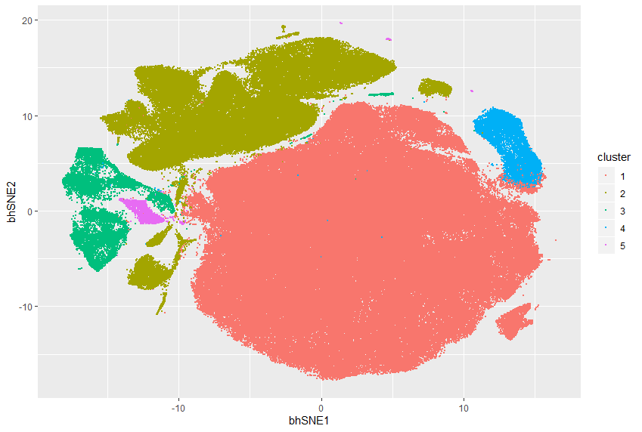
Notes:
ccRCC_643T_Myeloids 5

Slide 30
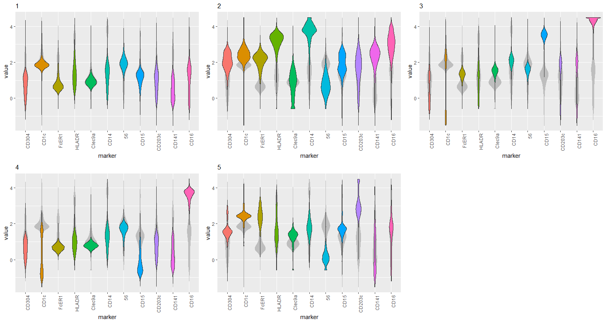
Notes:
ccRCC_643T_Myeloids 5

Slide 31
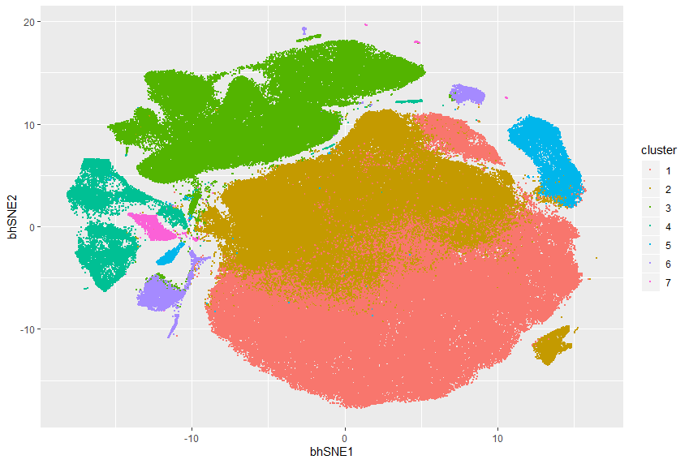
Notes:
ccRCC_643T_Myeloids 7
I tend to be very skeptical of arbitrary splits in embedding, especially if the violin plots show similar distributions.

Slide 32
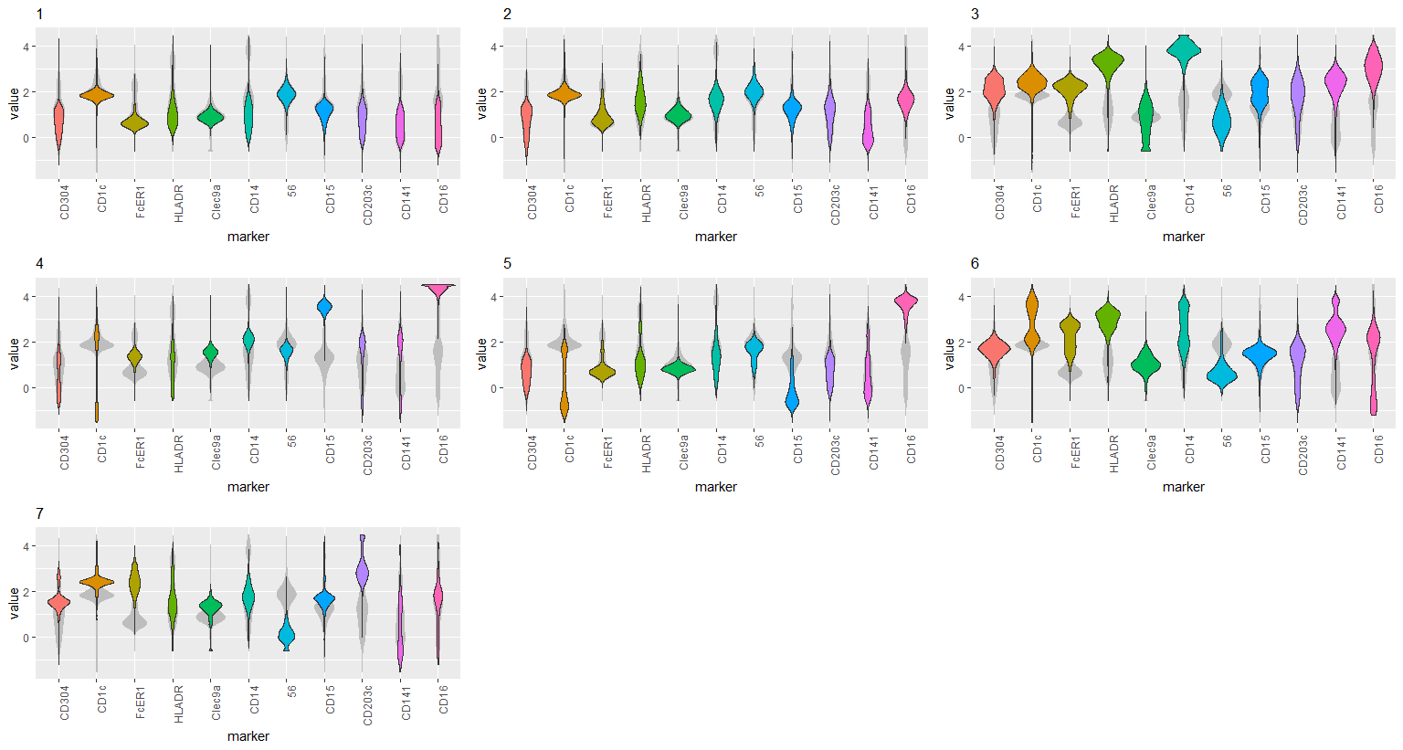
Notes:
ccRCC_643T_Myeloids 7

Slide 33
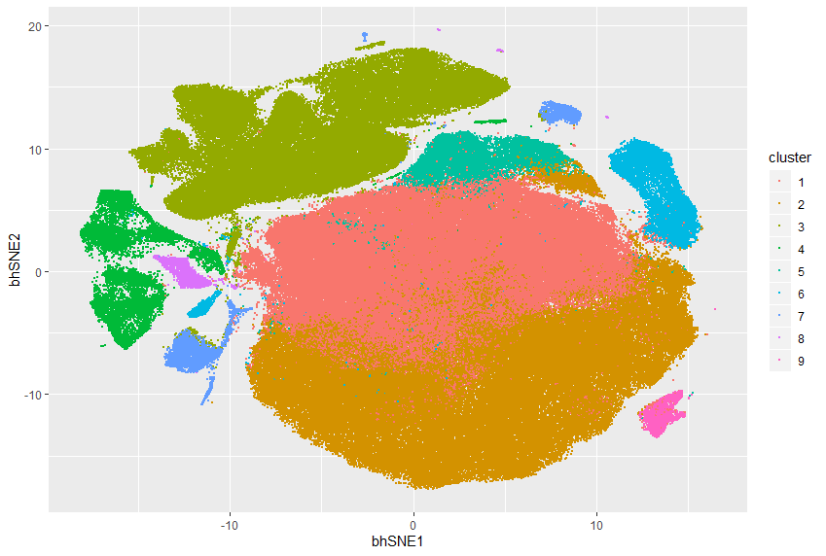
Notes:
ccRCC_643T_Myeloids 9

Slide 34
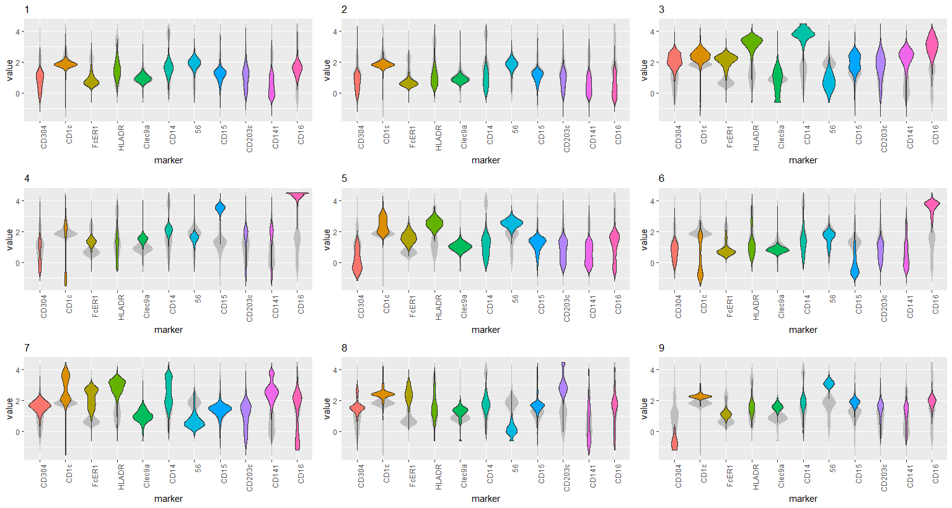
Notes:
ccRCC_643T_Myeloids 9

